Slide 1
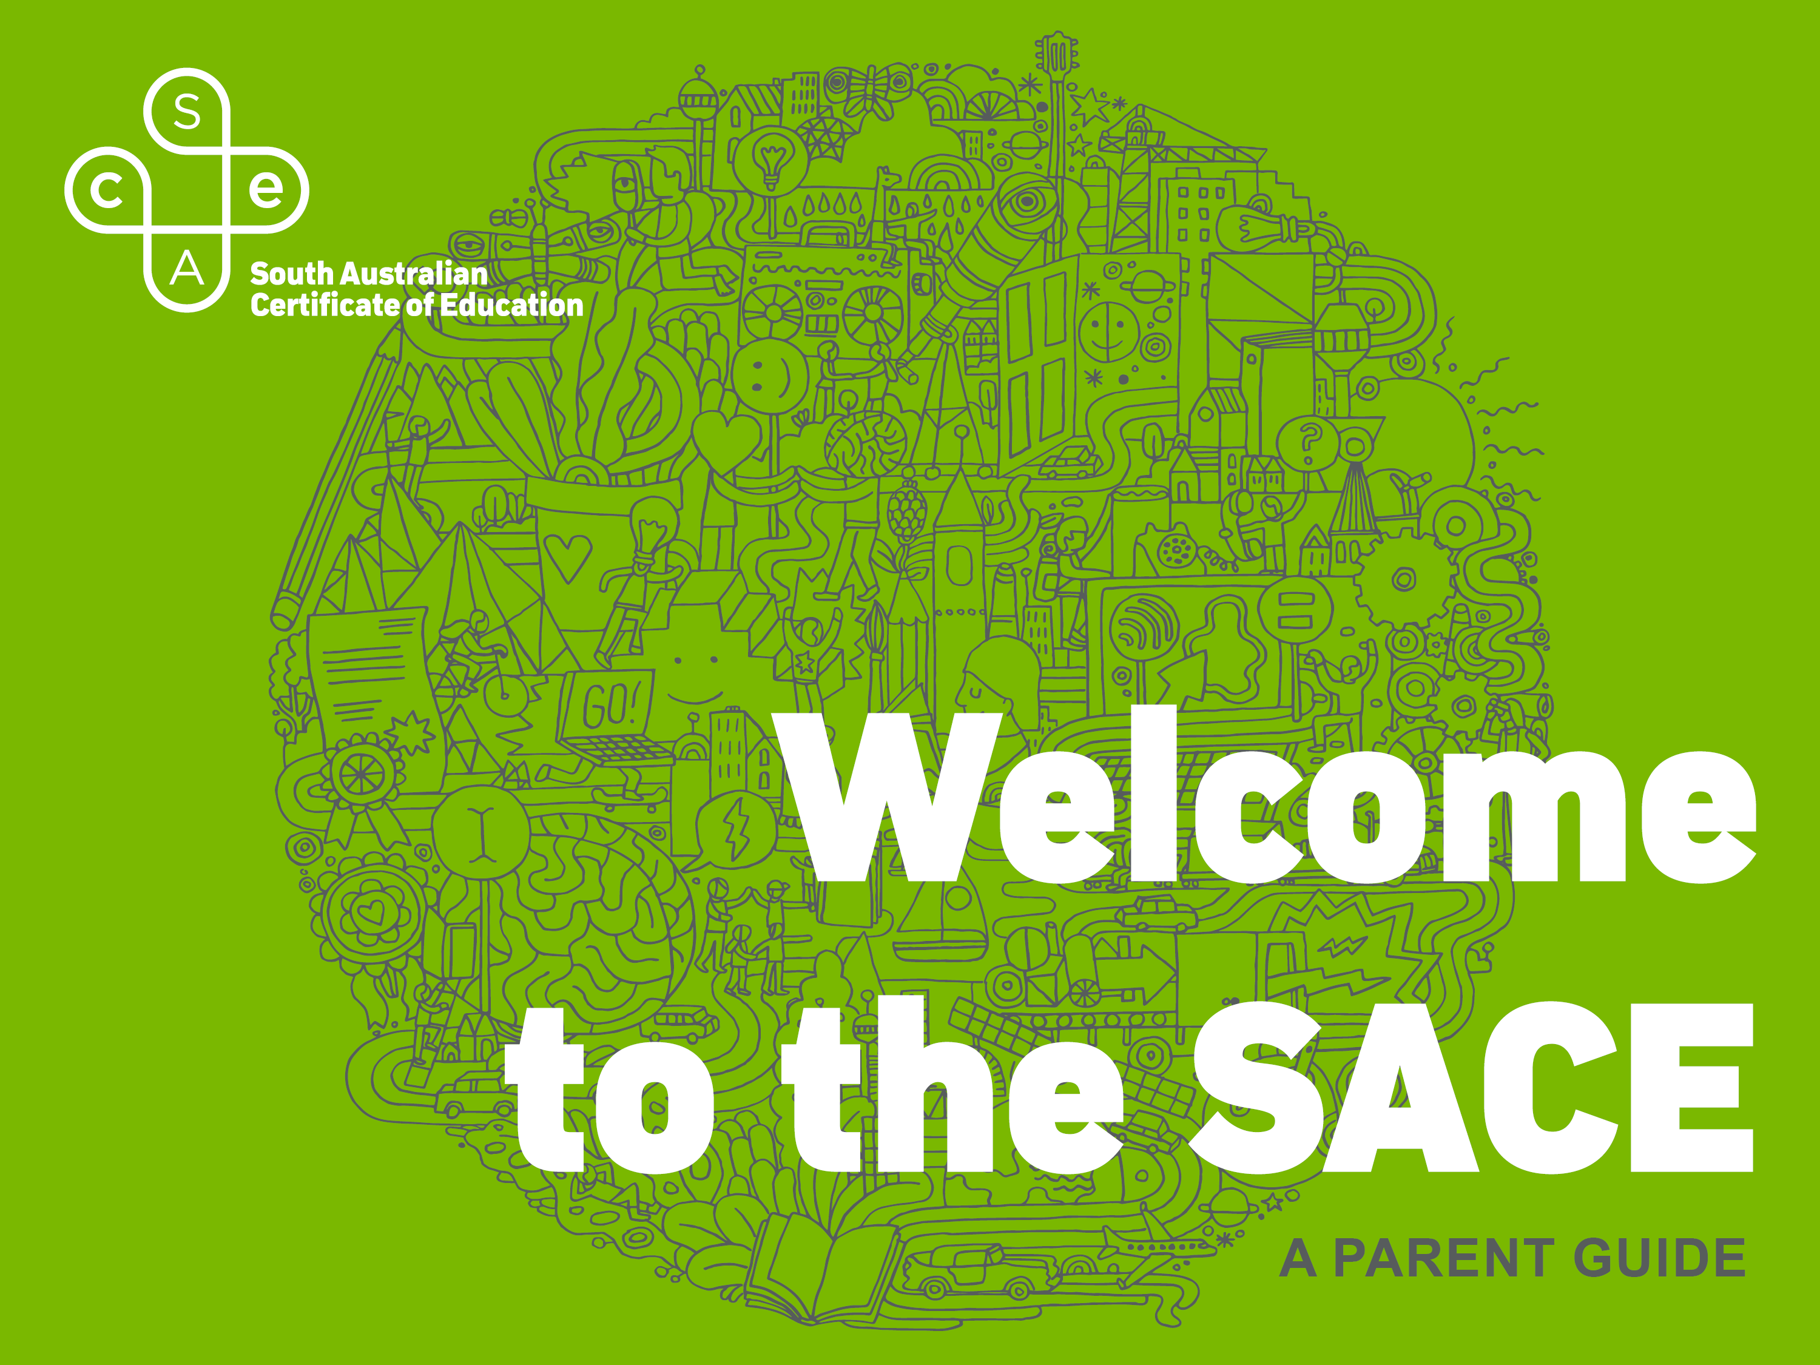

Slide 2


Slide 3

INTERNATIONALLY recognised qualification
DESIGNED to develop your child’s capabilities
SKILLS needed to be successful in the 21st century
FLEXIBLE timeframe and choice of subjects
Notes:
An internationally recognised qualification for life designed to help develop your child’s capabilities.
Designed to develop their skills and knowledge to live, work and participate successfully in an ever changing society.
Offer your child the flexibility to choose their subjects and complete the qualification in a timeframe that suits them and their lifestyle.

Slide 4
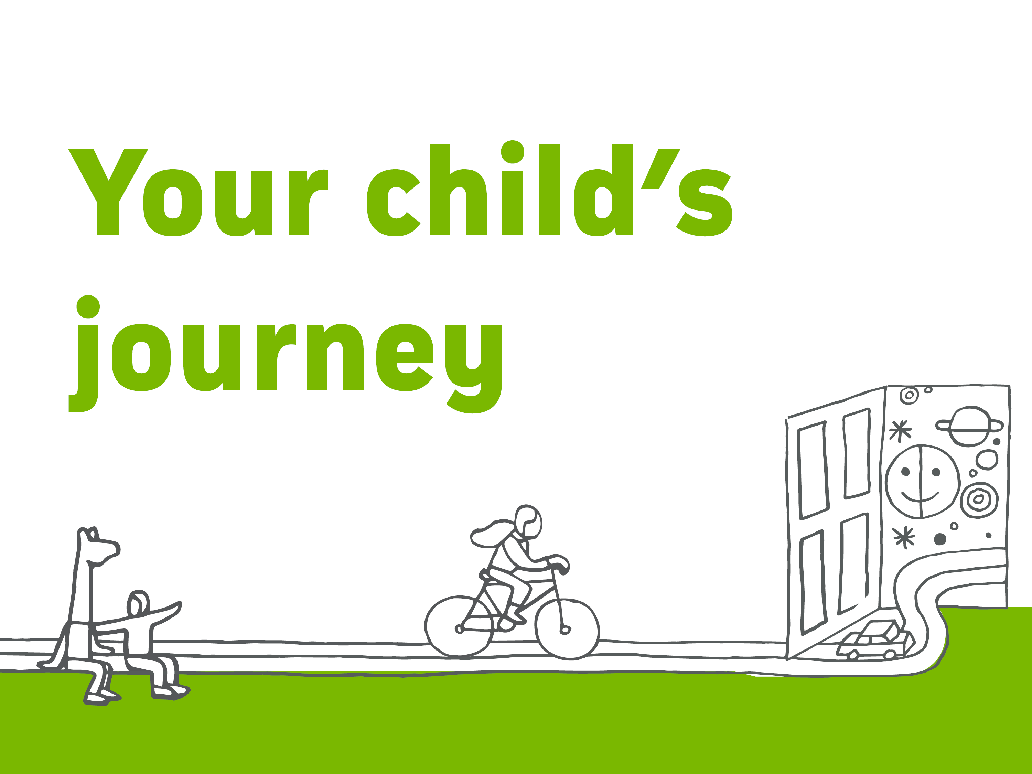
Notes:
Tonight we will be looking at your child’s SACE journey, how they will become a successful and resilient learner, a confident and creative individual and an active and informed citizen who at the end of their journey will be ready to succeed in further education, training or the workforce.
To start we will take a quick look at how the SACE works.

Slide 5
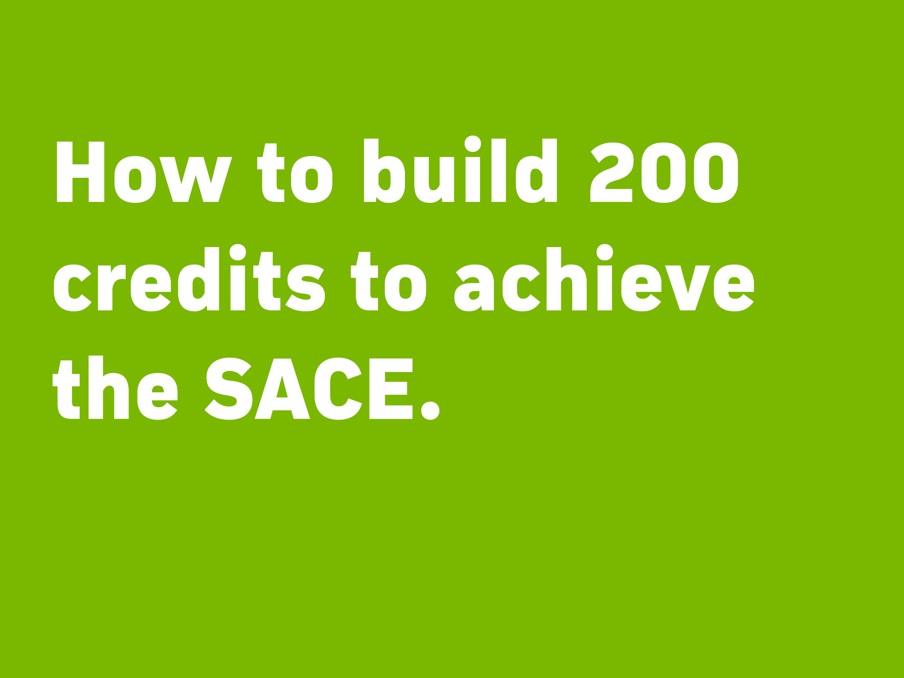
Notes:
Building your credits – SACE Animation

Slide 6
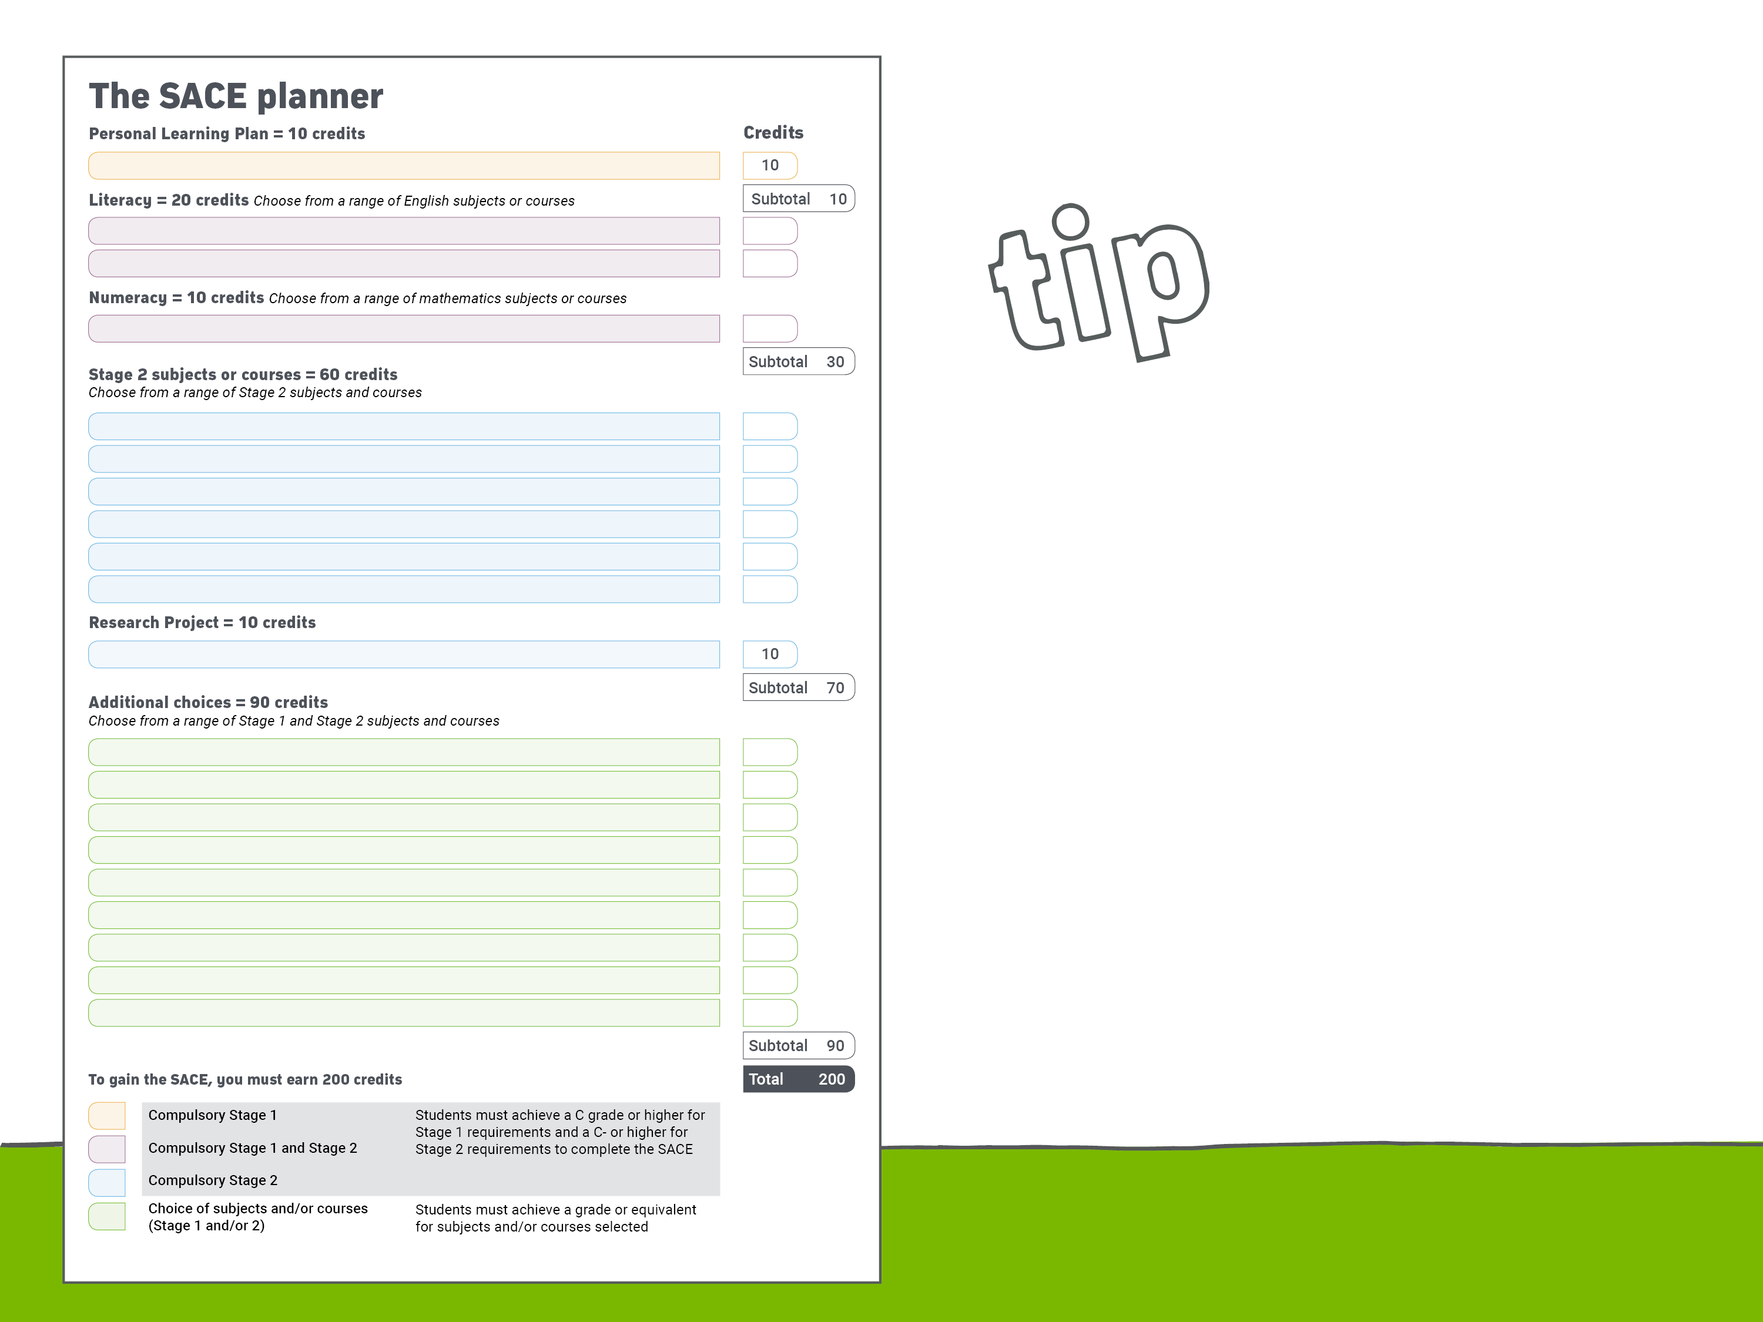
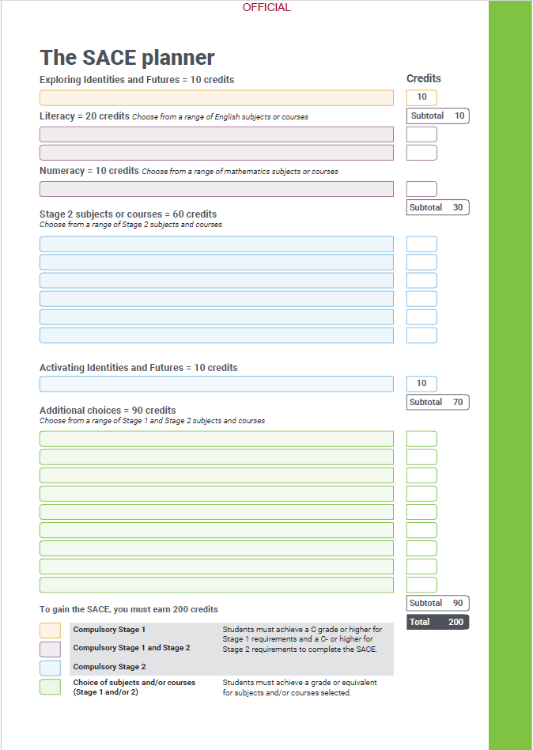
WHEN choosing Stage 2 subjects, your child should keep in mind any subjects that are required for the university courses they may be interested in.
TIP
Notes:
The SACE Planner outlines the requirements and can help your child with their subject selection.
TIP: When choosing Stage 2 subjects, your child should keep in mind any subjects that are required for the university courses they are interested in.

Slide 7

WHAT IS THE EIF?
EXPLORING IDENTIDIES & FUTURES
10 Credit – Stage 1 Subject
EXPLORE student’s Identity – Who am I? and Future – Where am I going
PROVIDES students opportunity to explore an area of interest
BUILDS 21st century capabilities that help students thrive inside & outside of the classroom
PREPARES students for a different way of thinking and leaning during senior school
ACHIEVE a C grade or higher to receive your SACE
Notes:
Your child’s SACE journey starts with the Personal Learning Plan (PLP).
What is the Personal Learning Plan (PLP)?
A 10-credit Stage 1 subject
Encourages your child to think about their choices
Identifies their interests and strengths
Sets personal and learning goals
Look at their future options and consider different career paths
Creates a solid foundation for Year 11 and Year 12 studies
Helps identify what subjects they might like to study
Participate in courses and activities outside school that will help them achieve their goals.
Your child will need to achieve at least a C grade.

Slide 8

WHAT IS ACTIVATING IDENTITIES AND FUTURES?
Students explore ideas related to an area of personal interest through a process of self-directed inquiry.
Using your own approach, behaviours and emotions to progress learning.
Understanding how you think and learn in different situations.
Exploiting your strengths and identifying areas for improvement.
Stopping and thinking about your own work.
Formerly the ‘Research Project’
Notes:
What is Activating Identities and Futures?
Students explore ideas related to an area of personal interest through a process of self-directed inquiry.
• using your own approach, behaviours and emotions to progress learning
• understanding how you think and learn in different slituations
• exploiting your strengths and identifying areas for improvement
• stopping and thinking about your own work
• revealing and sharing your thinking

Slide 9
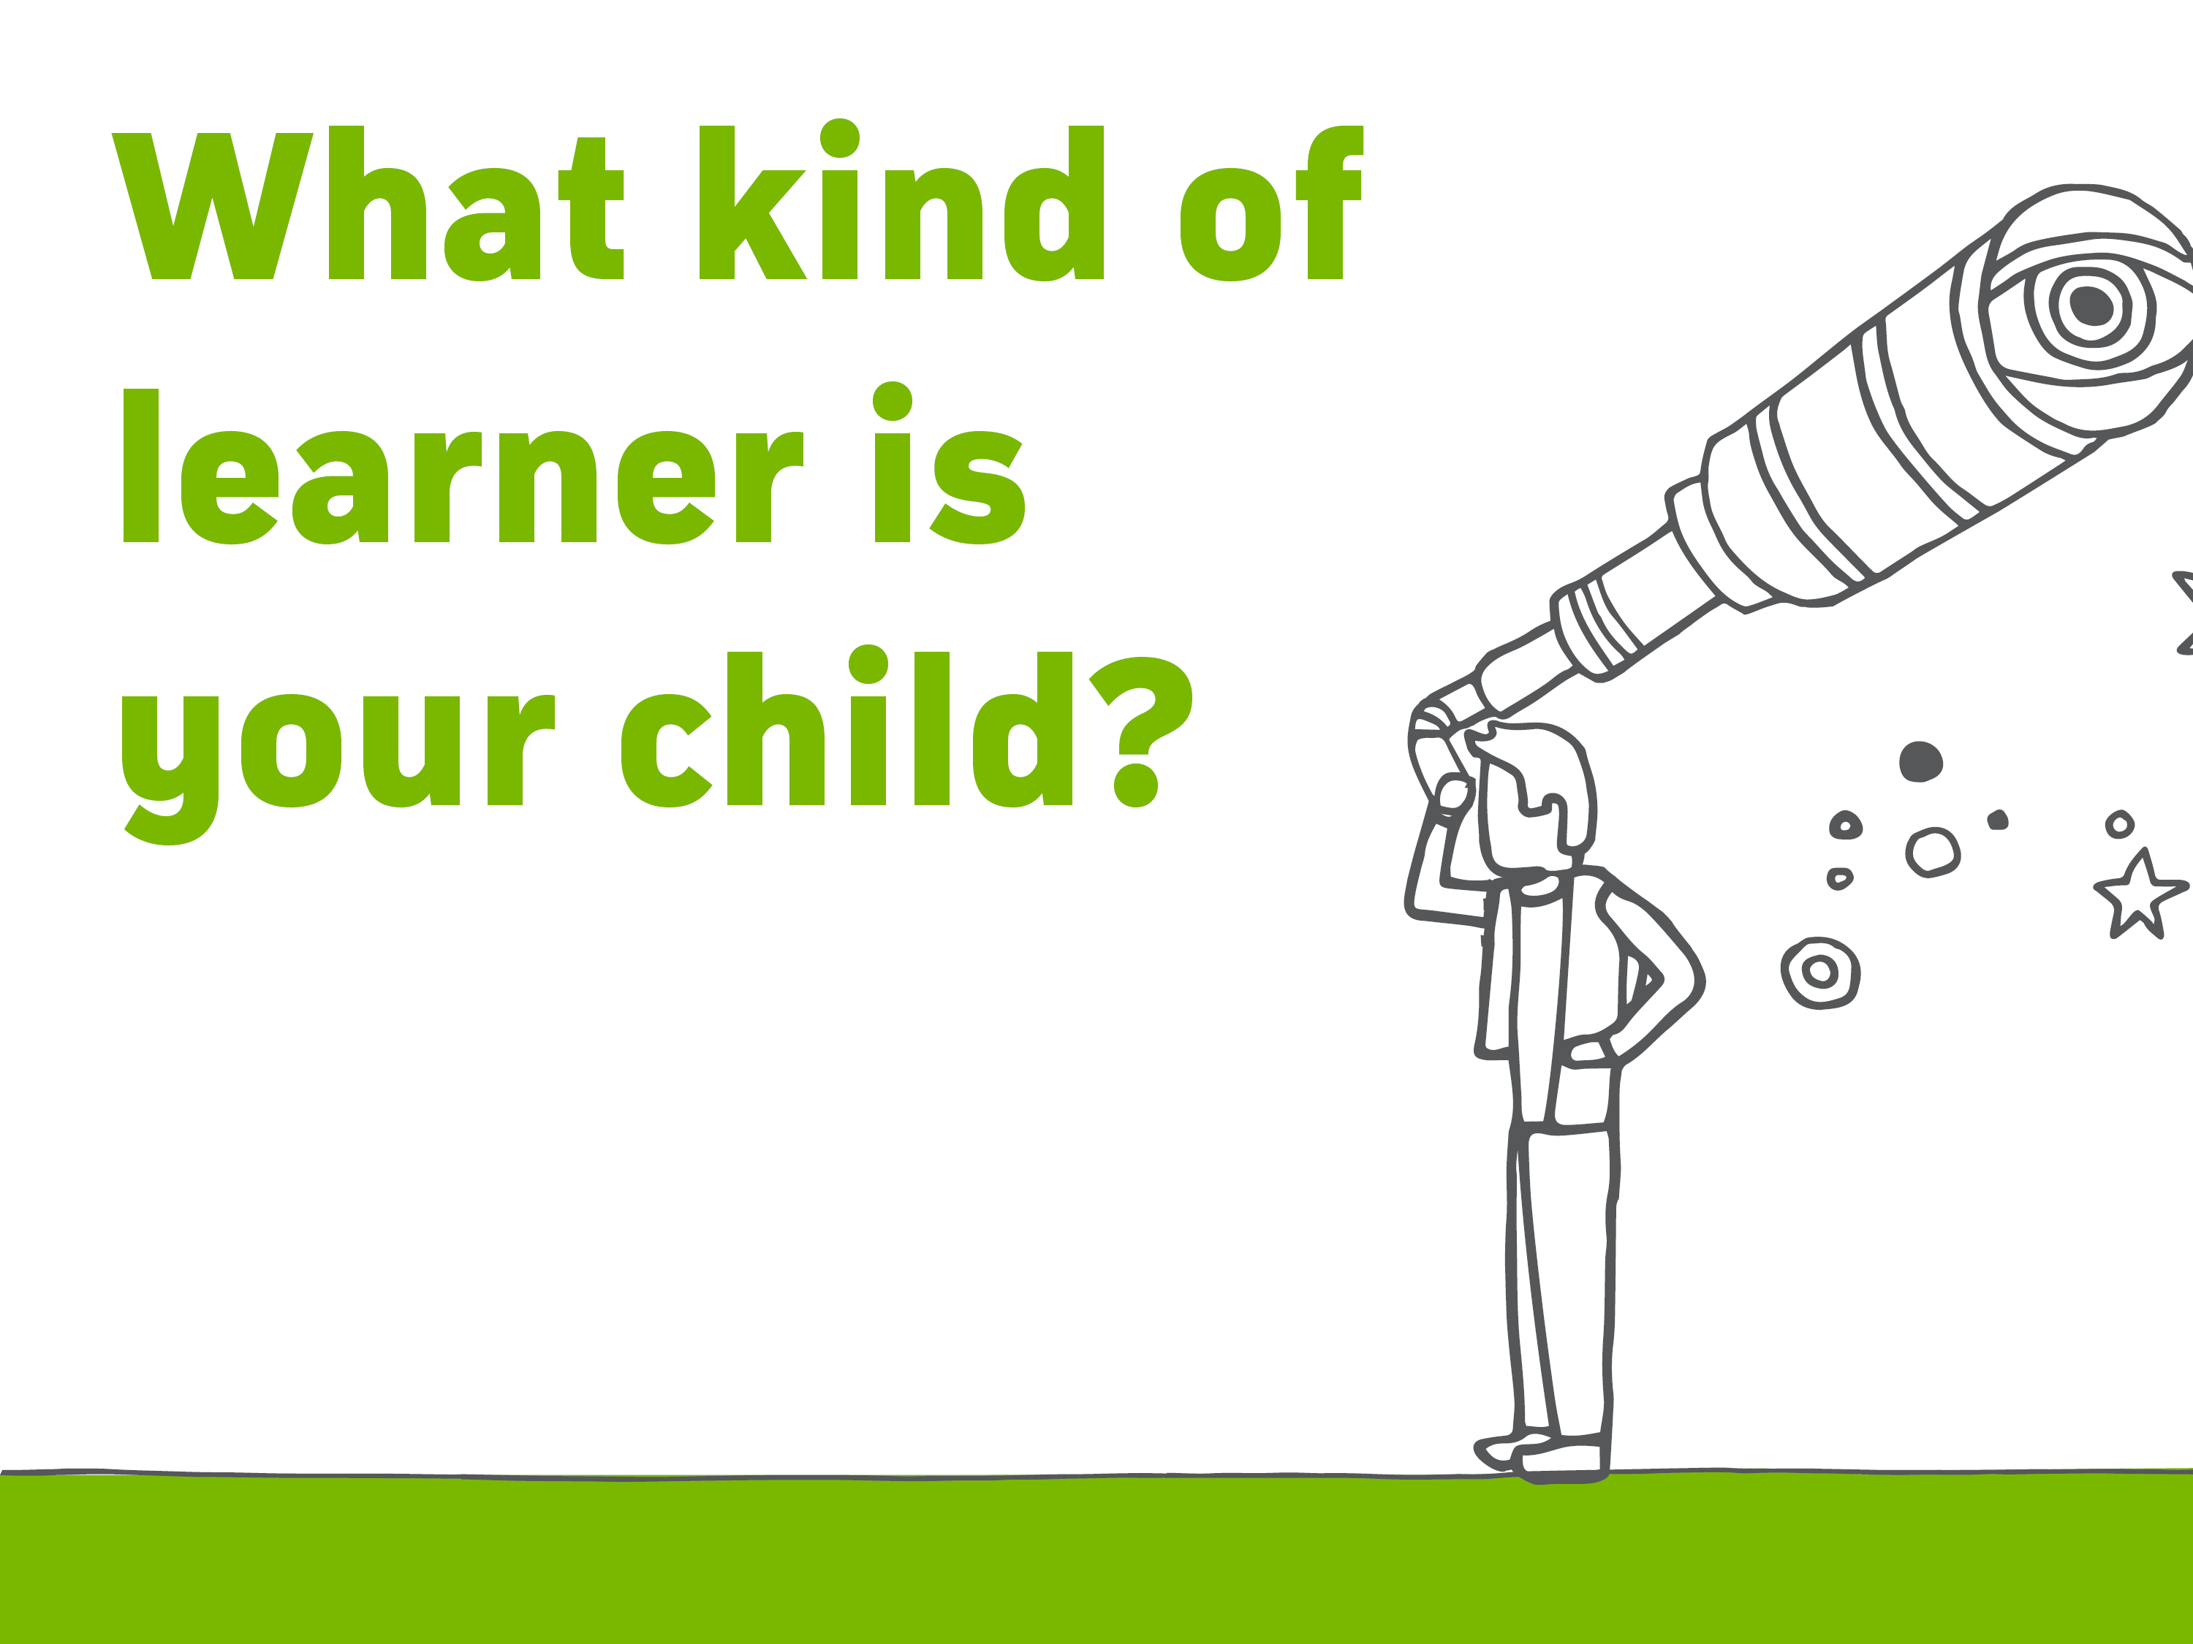
LEARN in and outside the classroom
COMBINE SACE subjects, community learning, VET, university and TAFE studies
FLEXIBILITY to study, work part time, complete a traineeship or apprenticeship
COMPLETE the SACE with job-ready skills
Notes:
The SACE is flexible, and caters for learning both in and outside school.
Students can combine study and part time work, a traineeship or school-based apprenticeship.
Students can receive credits for a wide range of activities and training:
SACE subjects
Vocation education and training (VET)
Community learning
University and TAFE studies
VET options are available at both Stage 1 and Stage 2 and include a wide range of industry areas, including construction, automotive, electro technology, hospitality, community services, health and information technology.
You can find a range of Stage 1 and 2 subjects offered, vocational education and training (VET) courses plus other options on the SACE website.

Slide 10
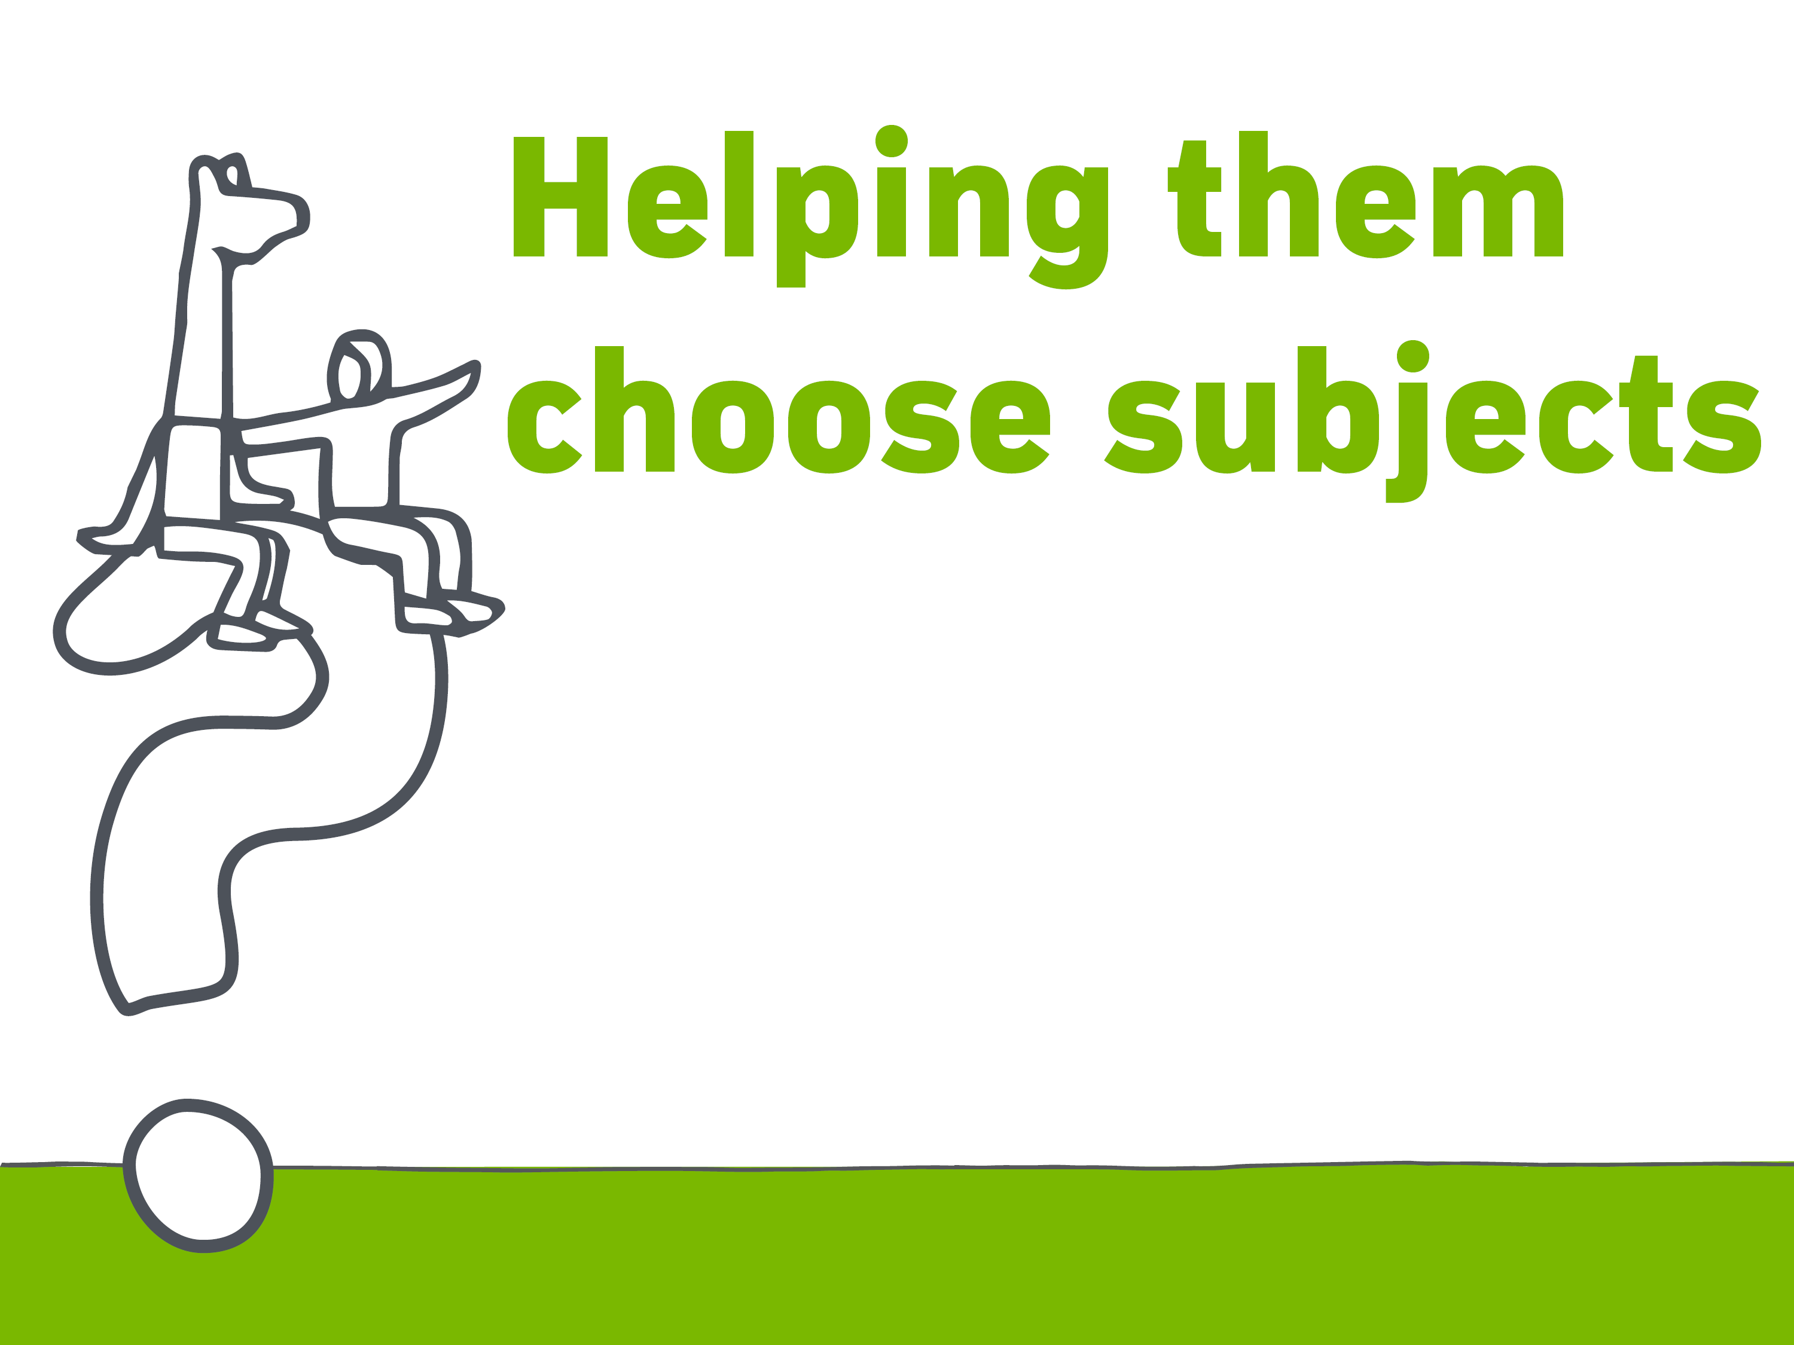
WHAT…
What am I interested in and good at?
What sort of job, or types of work, will help me follow my interests?
What subjects do I need to study to follow my chosen career pathway?
Prerequisites?
Assumed Knowledge?
What do I hope to gain from my studies?
What have I learned during my EIF course?
Find out more at sace.sa.edu.au/studying/subjects
Notes:
Questions for your child to ask themselves:
What am I interested in?
What am I good at?
What sort of job, or types of work, will help me follow my interests?
What subjects do I need to study to follow my chosen career pathway?
What I hope to gain from my studies?
What have I learned during my PLP course?
TIP – encourage them to try and choose subjects that will open doors to a range of careers within their area of interest
This will give them greater flexibility if they want to change or modify their choice in the future.
You can find out more about credits and choosing subjects, VET courses and recognised learning on the SACE website.

Slide 11

Planning for
AIF 1 Semester
Year 11
10 Credits
COMPULSORY
REQUIREMENTS
At least 2 Semesters of English
At least 1 Semester of Maths
20 credits
10 credits
NHS Course Counselling in Term 3 – With Student, Parent & HG Teacher
Notes:
Year 11 is when most students begin a full year of Stage 1 SACE study.
There are two compulsory requirements to be completed in Stage 1, these are usually achieved in Year 11:
at least two semesters of one or more English subjects (20 credits)
at least one semester of a mathematics subject (10 credits)

Slide 12
Planning for Year 12
AIF is the only compulsory Stage 2 subject (year 11 at NHS).
All subjects are whole year, 20 credit subjects, requiring at least a C grade.
4 Subjects for an ATAR. 3 Subjects for SACE Certificate
NHS Course Counselling in Term 3 – with Student, Parent & House Leader / HG Teacher
Notes:
There is one compulsory subject in Stage 2 — the Research Project.
The Research Project is a compulsory Stage 2 subject
It is a one semester, 10 credit subject.
Often completed in Year 11; however some schools offer this to students in Year 12.
From 2025, the Research Project will be replaced with Activating Identities and Futures (AIF).

Slide 13

PERFORMANCE STANDARDS
are used by teachers to decide how well a student has demonstrated their learning.
These standards assist in determining student GRADES.
STAGE 1 is school assessed Grading: A to E
STAGE 2 is a shared responsibility between our school and the SACE Board. Grading: A+ to E–
Notes:
Student work in the SACE is assessed through the use of performance standards. SACE subjects are assessed by the school at Stage 1. The responsibility for assessment at Stage 2 is shared between schools and the SACE Board.
Teachers and assessors use the performance standards to decide how well a student has demonstrated his or her learning.
The performance standards, which are provided in each subject outline, describe in detail the level of achievement required to obtain a grade:
from A to E for Stage 1
from A+ to E– for Stage 2.
SACE quality assurance processes are in place to ensure that grades across the state are consistent.
Moderation – student work is marked by the teacher and samples are sent to the SACE Board for moderation.
Marking – 30% of Stage 2 subjects are externally assessed, which means they will be marked by someone other than your child’s teacher, and overseen by the SACE Board.

Slide 14

MODERATION
Notes:
Student work in the SACE is assessed through the use of performance standards. SACE subjects are assessed by the school at Stage 1. The responsibility for assessment at Stage 2 is shared between schools and the SACE Board.
Teachers and assessors use the performance standards to decide how well a student has demonstrated his or her learning.
The performance standards, which are provided in each subject outline, describe in detail the level of achievement required to obtain a grade:
from A to E for Stage 1
from A+ to E– for Stage 2.
SACE quality assurance processes are in place to ensure that grades across the state are consistent.
Moderation – student work is marked by the teacher and samples are sent to the SACE Board for moderation.
Marking – 30% of Stage 2 subjects are externally assessed, which means they will be marked by someone other than your child’s teacher, and overseen by the SACE Board.

Slide 15
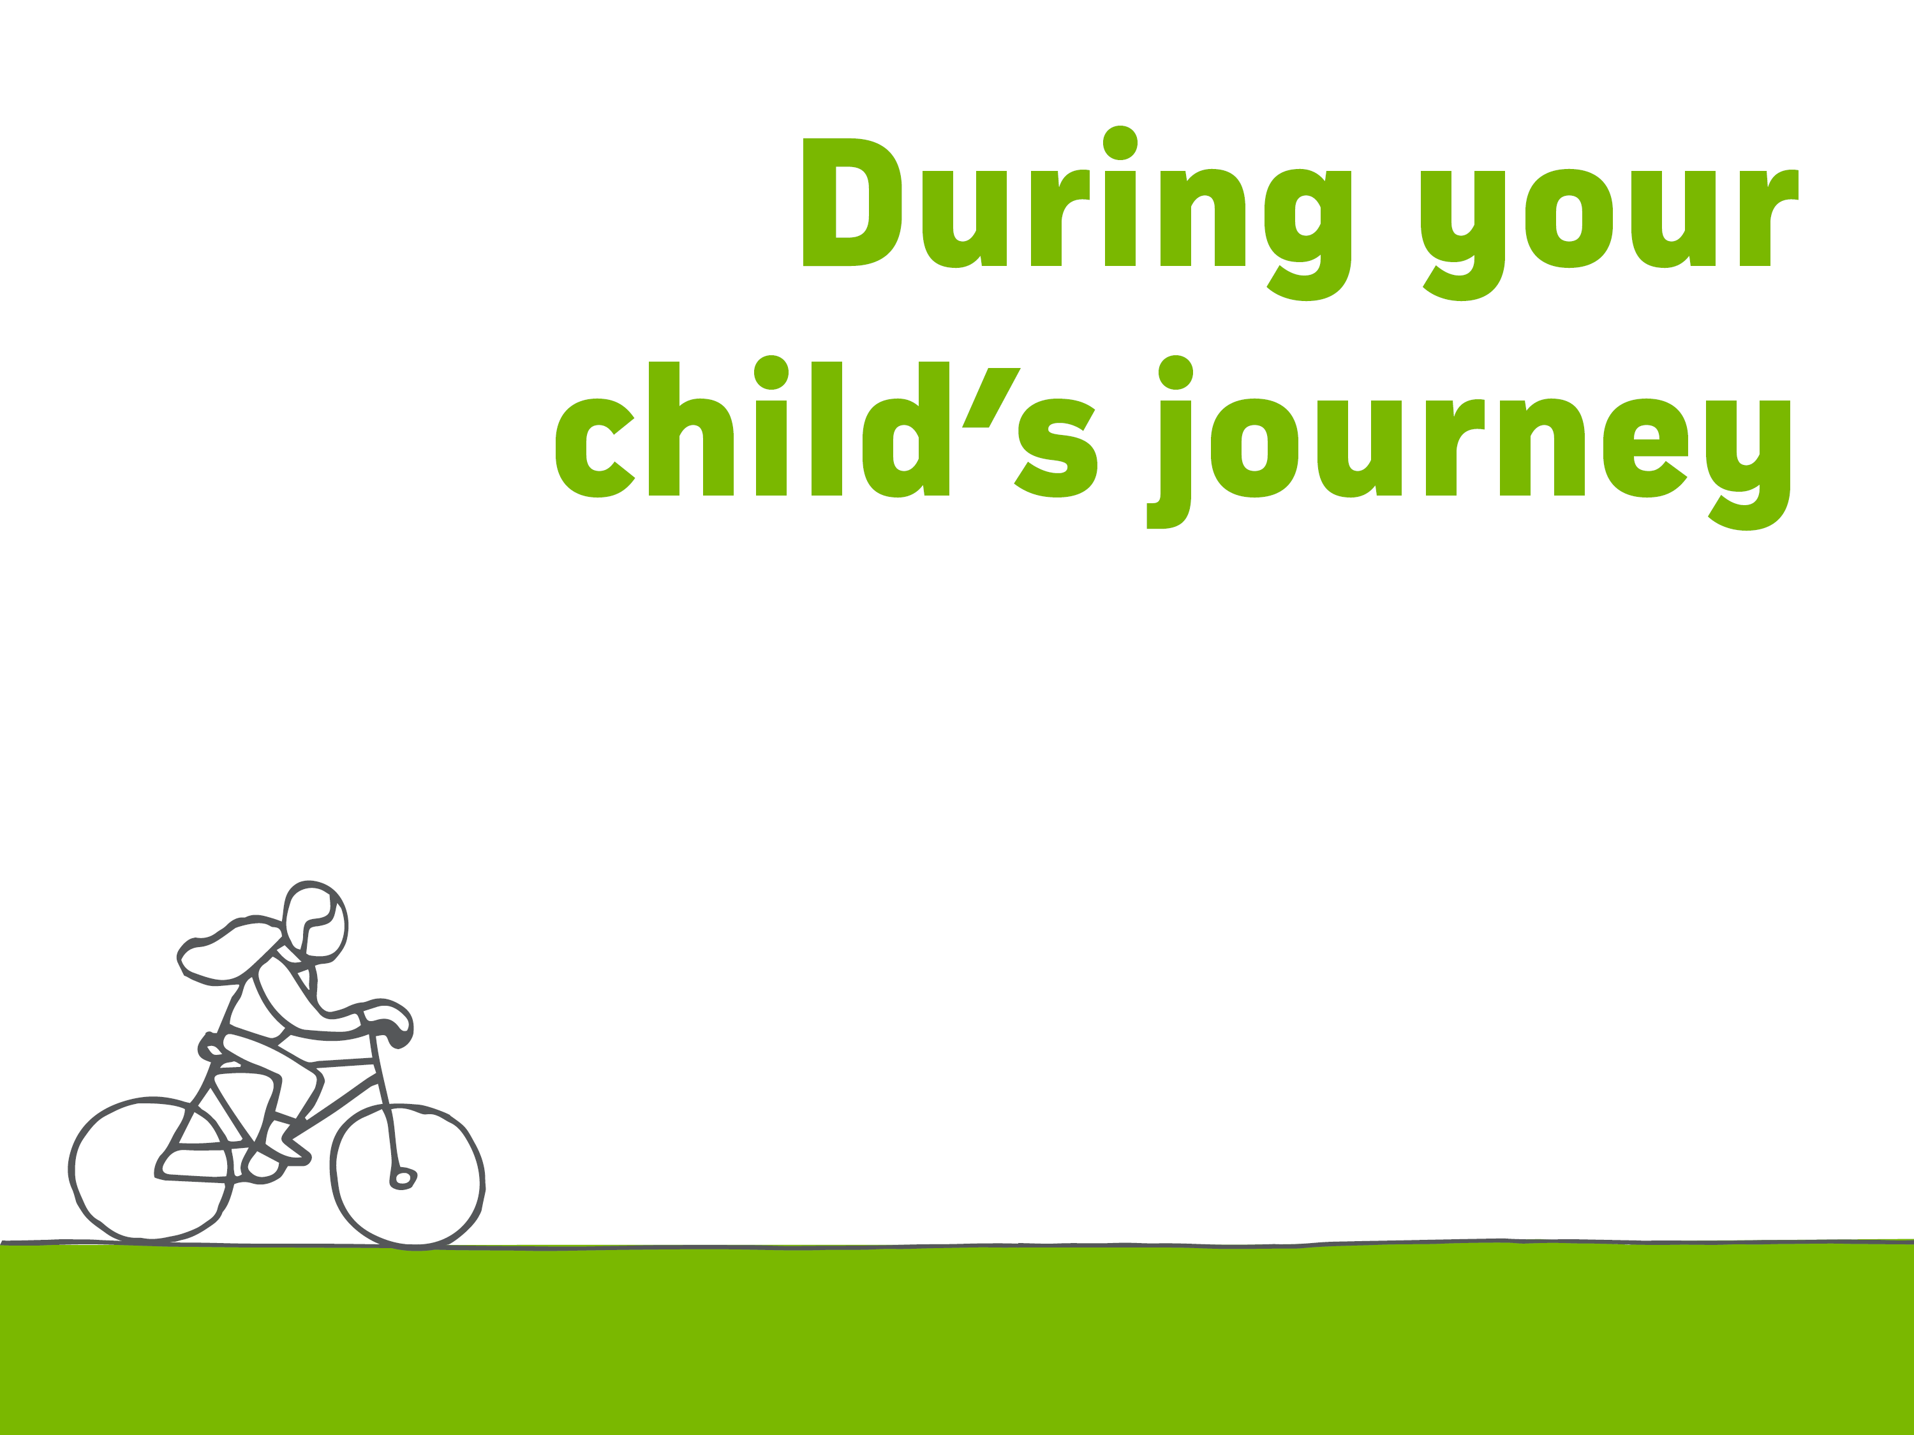
THE SACE Board supports students by working with schools to provide reasonable adjustments where appropriate.
SPECIAL PROVISIONS support eligible students to ensure they have the opportunity to positively demonstrate their skills and understanding of the subject.
MODIFIED subjects are available for students with significant impairment in intellectual functioning and/or adaptive behaviours associated with their disability.
Notes:
Sometimes a student’s journey is complicated by disability, misadventure or personal circumstances.
Special provisions
Special provisions are a range of adjustments that are made to allow eligible students to access learning and assessment on the same basis as other students. These might be adjustments such as extra time for tests, extended deadlines or using adaptive technology.
Special provisions are available in stages 1 and 2 and for both the school assessed and externally assessed components. Special provisions may administered for a short term or on a long term basis according to the needs of the student. Each case is individual.
Modified Subjects
Access to modified subjects is intended for the small number of students with significant impairment in intellectual functioning and/or adaptive behaviours associated with their disability, whose learning needs cannot be met through differentiation or special provisions.
This group of eligible students has access to modified subjects which focus on personalised learning goals and the development of the capabilities.
Subjects are assessed as ‘Completed” or ‘Not Completed”.
Eligible students may also access the full range of flexible subjects and VET to complete their SACE.
www.sace.sa.ed.u.au/web/modifed-subjects

Slide 16

RESULTS
Your child will receive their final results in Students Online on the SACE website. sace.sa.edu.au
SATAC
Provides students with their ATAR satac.edu.au
Notes:
At the end of Stage 2, your child will receive their final results for all SACE subjects they have completed. These grades are available in Students Online on the SACE website.
On the same day the South Australian Tertiary Admissions Centre (SATAC) will release the ATAR and your child will be able to find out if they are eligible for:
an Australian Tertiary Entrance Rank (ATAR) which they can use to apply for university

Slide 17

Australian Tertiary Admissions Rank issued by SATAC and used by universities to select students for courses
MEASURES a student’s overall achievement compared with all students nationally
RANGES from 0 to 99.95.
The score is calculated from your child’s 90 credit, Stage 2 results
Notes:
What is an ATAR?
An Australian Tertiary Admissions Rank is used by universities to select students for courses.
It measures a student’s overall achievement compared with all students nationally and ranges from 0 to 99.95
The score is calculated from your child’s 90 credit, Stage 2 results.

Slide 18
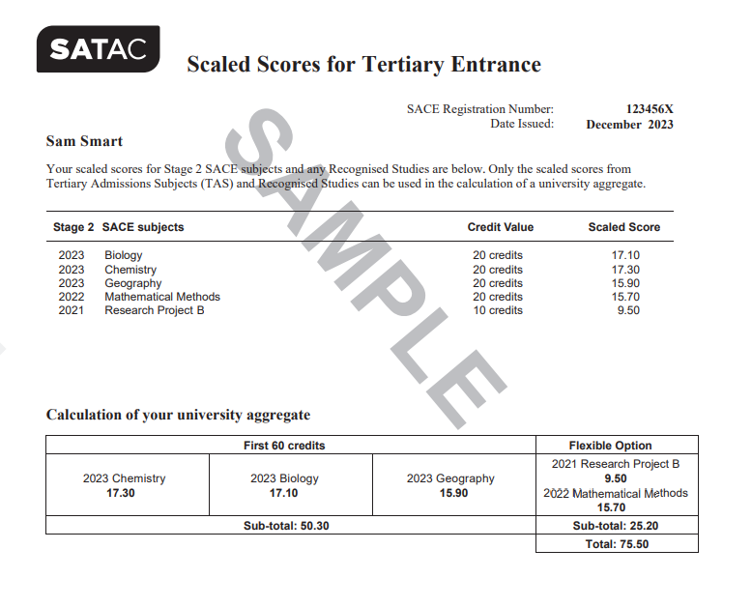
Notes:
University Aggregate

Slide 19
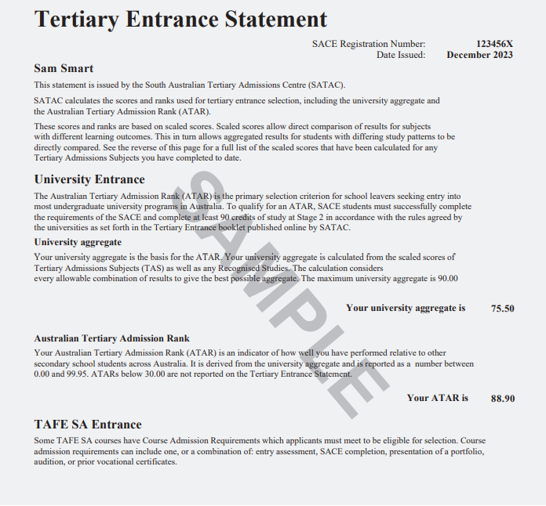
Does not count
Bonus Points
Notes:
Tertiary Entrance Statement

Slide 20

SATAC has two schemes that provide adjustment factors to applicants to calculate your selection rank.
1. The Universities Equity Scheme – 5 points
2. The Universities Language, Literacy and Mathematics Scheme – 2 or 4 points
Maximum of 9 points
Naracoorte High School is a school that qualifies under the Universities Equity.
Bonus Points
https://www.satac.edu.au/scaling
https://www.satac.edu.au/adjustment-factors Learn more about scaling and adjustment factors

Slide 21
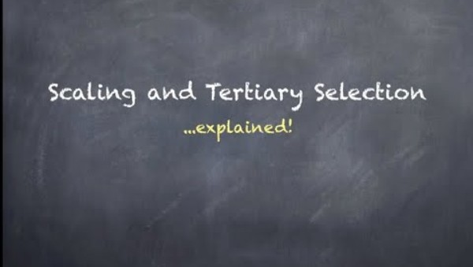
Let’s say you get a B- in both Stage 2 Essential English and Stage 2 Essential Maths
If the average score for English is a C+ then you are above the average and your score will be scaled UP
If the average score for Maths is a B then you are below the average and your score will be scaled DOWN
Scaling
https://www.satac.edu.au/scaling
https://www.satac.edu.au/adjustment-factors Learn more about scaling and adjustment factors

Slide 22
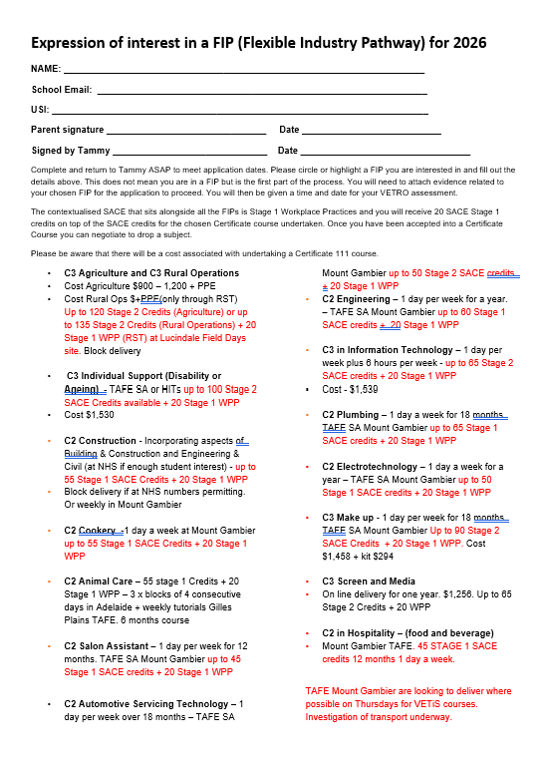
FIP - Flexible Industry Pathways
SBA - School Based Apprenticeships
FIPs & Schools Based Apprenticeships count for Stage 1 or Stage 2 Credits, depending on the course Any SBA (Cert III) satisfies all non compulsory credits.
20 Credits of a Cert III can be used towards an ATAR.
Tammy Schinkel
Tammy.Cane985@schools.sa.edu.au
TIP
Notes:
The SACE Planner outlines the requirements and can help your child with their subject selection.
TIP: When choosing Stage 2 subjects, your child should keep in mind any subjects that are required for the university courses they are interested in.

Slide 23
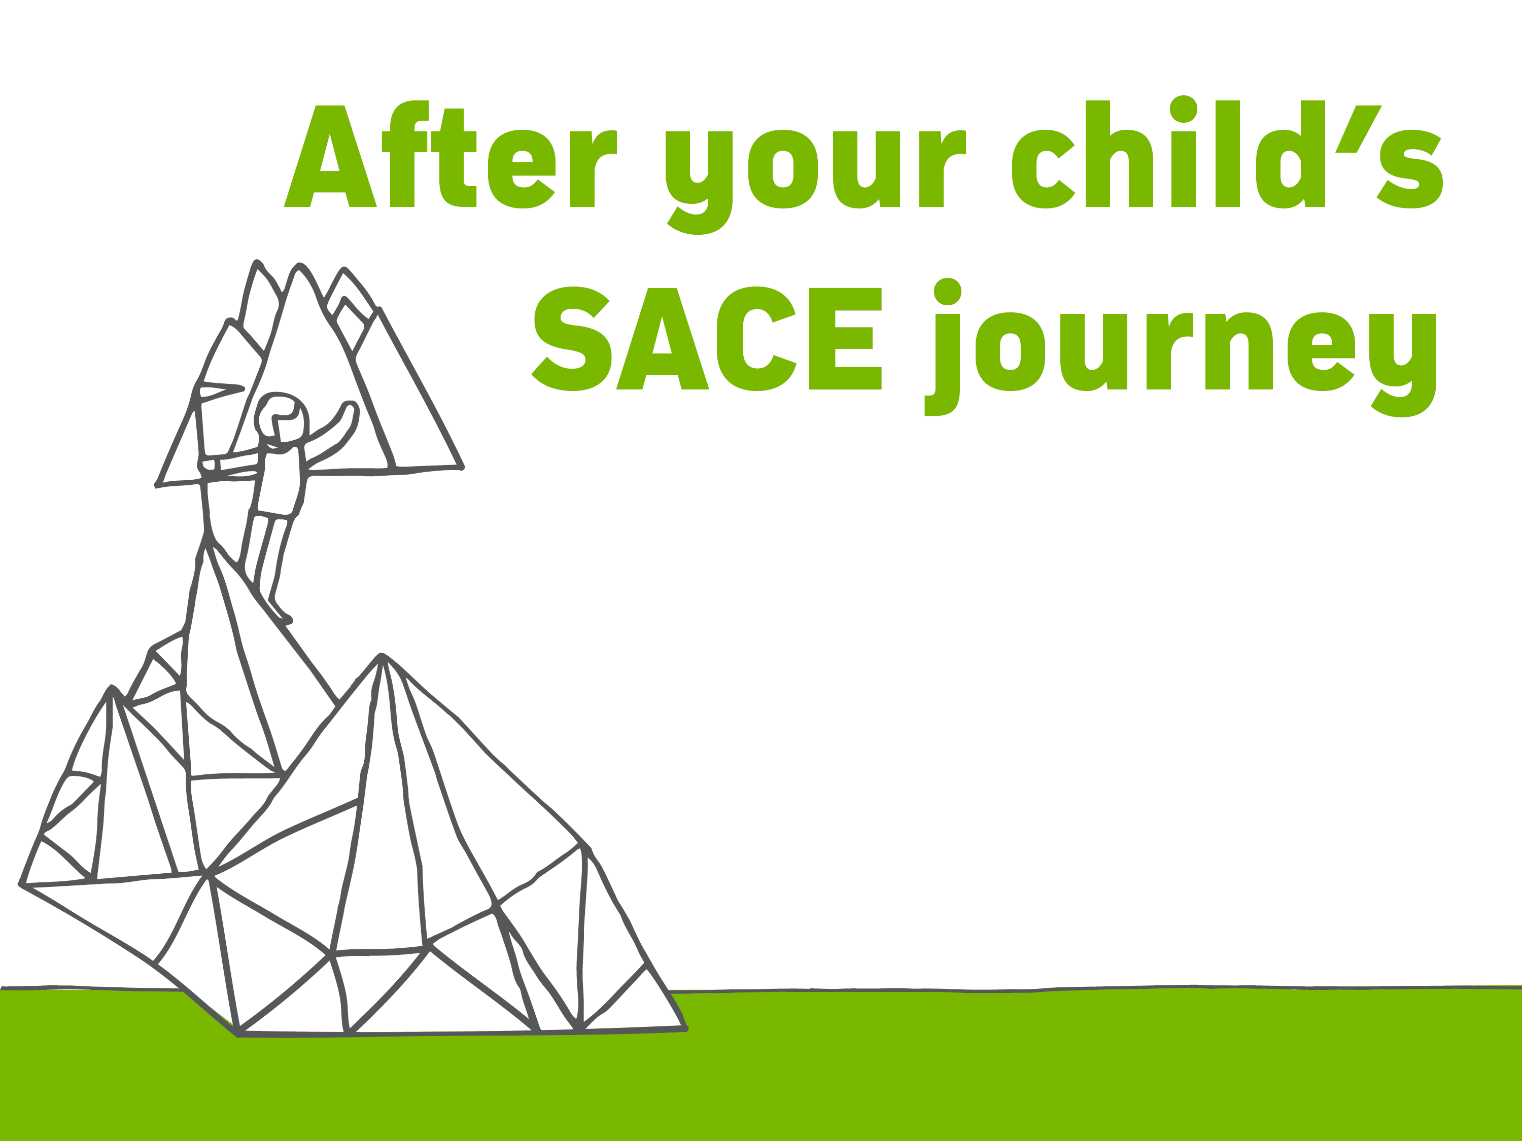
UNIVERSITY
COMPLETED the SACE with at least 90 credits at Stage 2
GAINED a university aggregate and an ATAR
MET any university prerequisite requirements and rules
APPLIED through the South Australian Tertiary Admissions Centre (SATAC)
Opens in August.
Notes:
Achieving the SACE is important if your child wants to study at TAFE or university, but there are also other pathways after secondary school. The SACE also offers the flexibility to move smoothly from high school to employment.
University pathways
Successful completion of the SACE is the most common way for students to gain entry to local and international universities.
To be eligible to apply for university, South Australian students must have:
completed the SACE with at least 90 credits at Stage 2
gained a university aggregate and an ATAR
met any prerequisite subject requirements for their chosen university course
complied with rules regarding subject combinations and counting restrictions
Application for entry to university courses is made through the South Australian Tertiary Admissions Centre (SATAC). More information is available in the SATAC booklet and on the SATAC website www.satac.edu.au.

Slide 24
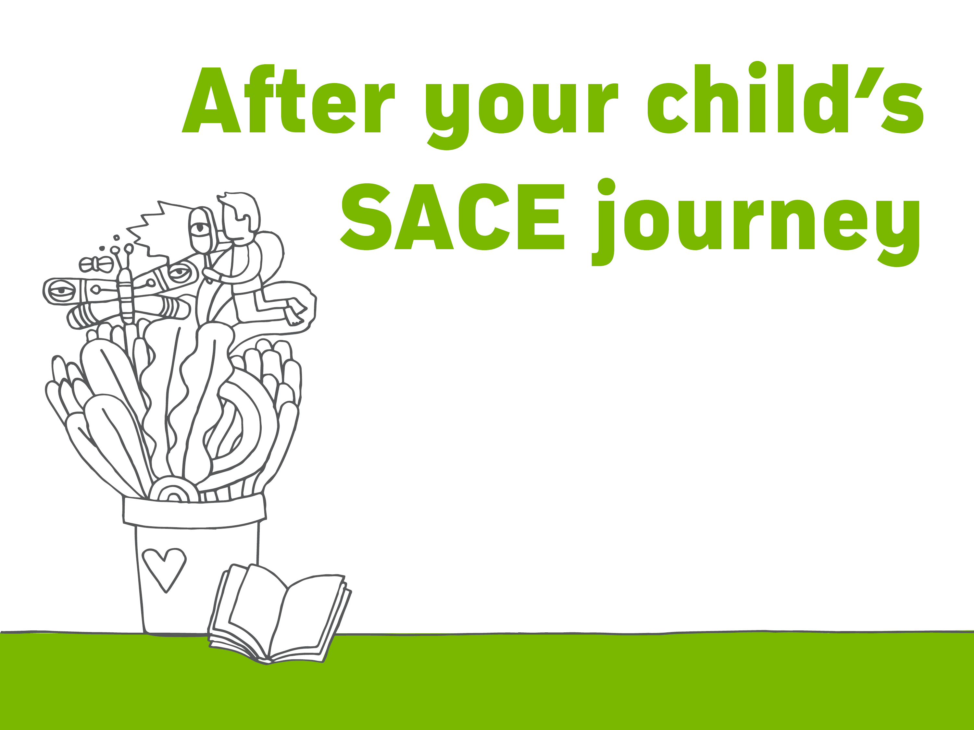
TAFE
ENTRY requirements and a list of all the courses offered by TAFE can be found at tafesa.edu.au
PREPARES your child for employment in professional, para-professional, technical and trade careers
Notes:
TAFE pathways
TAFE SA campuses offer courses to prepare your child for employment in professional, para-professional, technical and trade careers.
Entry requirements may vary depending on the level of the qualification.
Details of these requirements and a list of all the courses offered by TAFE can be found on the TAFE website.

Slide 25
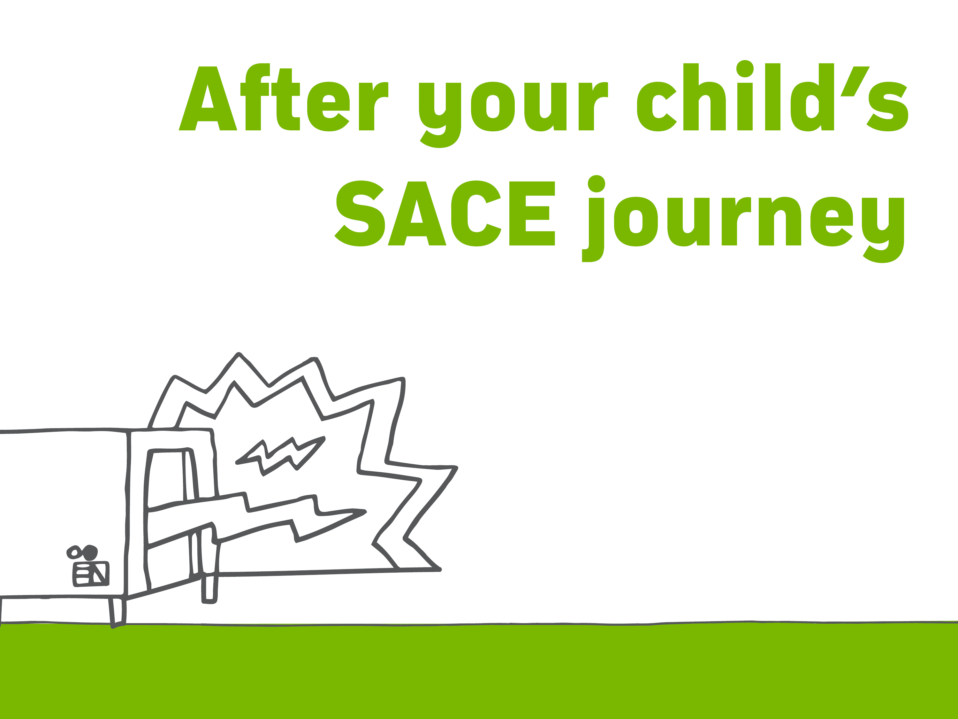
EMPLOYMENT AND TRAINING
TRAIN in a recognised VET course or school-based apprenticeship
while completing the SACE
GET a head start on their career
CHOOSE from a wide range of industry areas
Find a list of VET courses at sace.sa.edu.au
Notes:
Employment and training
The SACE offers the flexibility to move smoothly from high school to employment.
VET courses can count towards their SACE at both Stage 1 and Stage 2. This means they can be working towards, or may even have gained, a VET qualification by the time they finish the SACE – giving them a head start on their career and employment.
After completing their SACE your child can continue with their chosen pathway or start a new one, choosing from a wide range of industry areas, including construction, automotive, electro technology, hospitality, community services, health and information technology.
More information is available at www.skills.sa.gov.au/careers-jobs

Slide 26

OUR SCHOOL is here to provide information to you and your child
MY DETAILS
Tom Rechner
PHONE: 8762 1333
EMAIL:
Tom.Rechner439@schools.sa.edu.au
HELP your child select subjects that suit their interests and future plans
ADVISE them on the best subjects and VET courses to take for their preferred tertiary education course or area of employment
Notes:
Our school
Our school’s SACE coordinator, teachers and other school leaders are here to help and can:
Offer advice and information on the subjects being offered
Help your child select subjects that suit their interests and plans
Advise your child about the best subjects to take to prepare for their preferred tertiary education course or area of employment
Advise your child on vocational education and training (VET) options available to them, through our school or a registered training organisation (RTO).

Slide 27

?
Notes:
If you are looking for ways to further support your child through their SACE journey, more information can be found under ‘studying the SACE’ on the SACE website www.sace.sa.edu.au
Alternatively contact the SACE Board at:
60 Greenhill Road, Wayville
South Australia, 5034
8115 4700
SACE.Info@sa.gov.au

Slide 28


