Slide 1
Senior School Subject Selection 2025
Tom Rechner – Senior School & SACE Coordinator
Tom.Rechner439@schools.sa.edu.au

Slide 2
Course Counselling Process 2024
Weeks 1-3 students have attended presentations from subject teachers regarding the content and requirements for each subject
Information available in course booklet SeniorSchool-Handbook25.pdf
During Home Group, students have access to NHS Course Booklet, SATAC Guides, University and TAFE Guides
Students have been working with Home Group teachers to develop a draft of their 2025 subject selections
Web Preferencing opens mid week 2 - can be completed either:
In class
At home
A meeting with your HG teacher
Pathways to a Pay Packet – Monday week 4
All links and information on school website - https://www.narahs.sa.edu.au/

Slide 3
Notes:
Building your credits – SACE Animation

Slide 4
SACE Refresher

Slide 5
WHEN choosing Stage 2 subjects, your child should keep in mind any subjects that are required for the university courses they may be interested in.
TIP
Notes:
The SACE Planner outlines the requirements and can help your child with their subject selection.
TIP: When choosing Stage 2 subjects, your child should keep in mind any subjects that are required for the university courses they are interested in.

Slide 6
WHERE HAS THE RESEARCH PROJECT GONE?
Following feedback received from schools and the community in the 2018 SACE Stage 2 Review [PDF 172KB] the SACE Board began to redesign Stage 2 Research Project (RP), to be replaced with Activating Identities and Futures (AIF).
The intention behind AIF is for students to explore ideas related to an area of personal interest through a process of self-directed inquiry. They draw on relevant knowledge, skills and capabilities applying these in new contexts and selecting relevant strategies to progress the learning to a resolution.
At Naracoorte High School:
Students in Year 11 in 2024 – Research Project
Students in Year 11 in 2025 – Activating Identities & Futures (AIF)
Notes:
The Research Project is an important opportunity for students to develop skills relevant to their future beyond school.
The Research Project is a one semester (10 credit) compulsory subject.
Your child will research a topic question in-depth that really interests them and will explore their interest area using their creativity and initiative, and develop the research, presentation and project management skills they will need to be successful at university, further study, work and life.
Skills include the ability to analyse information, make judgement and evaluate.
Previous research questions include:
• ‘How the media influences the Australian asylum seeker debate?’
• ‘To what extent does the architectural redevelopment of the laneways in Adelaide contribute to making a more vibrant city?’
• ‘What is the best method for upholstering a chair?’
• ‘What is the future of the southern hairy-nosed wombat?’
If your child can’t think of a topic, try getting them to thinking about:
a topic that they are interested in, but haven’t had the chance to investigate
Their interests outside school
Their future plans and ambitions.

Slide 7
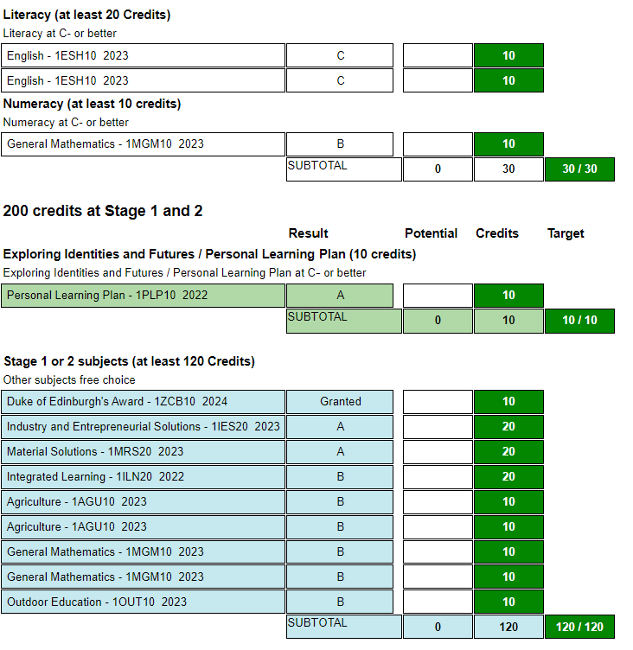
Stage 1 – Year 11 in 2025
Students continue to earn credits for subject & courses
Students need 200 total credits to achieve their SACE
At NHS we aim for 120 x Stage 1 credits Plus AIF / Research Project in year 11
Courses are graded A to E
Students must receive a C Grade or higher in compulsory subjects
2 x semesters of Literacy (English)
1 x Semester of Numeracy (Maths)
EIF – Exploring Identities & Futures (PLP)
AIF – Activating Identities & Futures (Research Project)
Most subjects run for 1 semester and are worth 10 x Stage 1 credits
Selected subjects will be moderated by the SACE Board
Stage 1 credits also available for recognised learning (Duke of Ed, CFS, Certificate Courses) https://www.sace.sa.edu.au/studying/recognised-learning

Slide 8
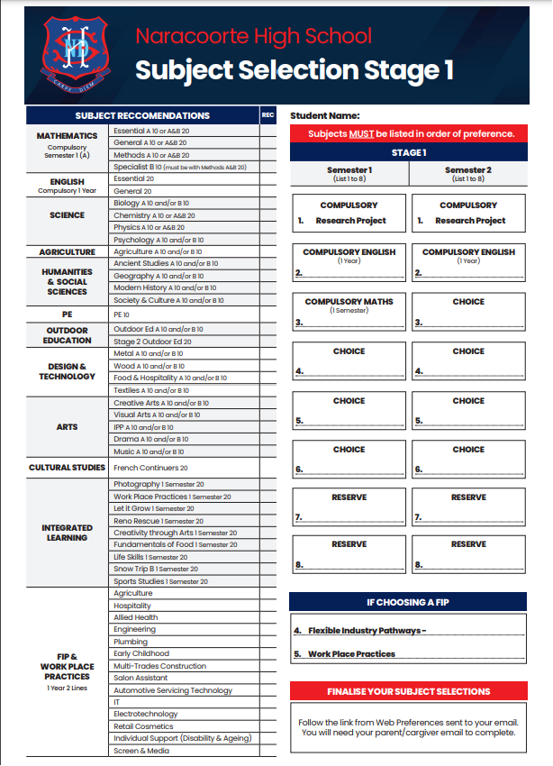
Year 10 into 11
Stage 1 2025
Compulsory Selections:
2 x Semesters of English
1 x Semester of Maths
1 x Semester of AIF (Research Project)
Elective Subjects
Choices from elective subjects
Subject Recommendations
Curriculum Teachers have completed these
FIP
Complete FIP Expression of Interest form & return to Tammy Cane

Slide 9
Year 10 Home Group Teachers
Amanda Mangelsen amanda.mangelsen262@schools.sa.edu.au
Tyrone Stapleton tyrone.stapleton813@schools.sa.edu.au
Supported by Career Strategy Leader Nadia Sears – nadia.sears738@schools.sa.edu.au
Bookings available with these teachers Monday 5th & Tuesday 6th August from 4-8pm. Book online through Sentral Parent Portal open week 1

Slide 10
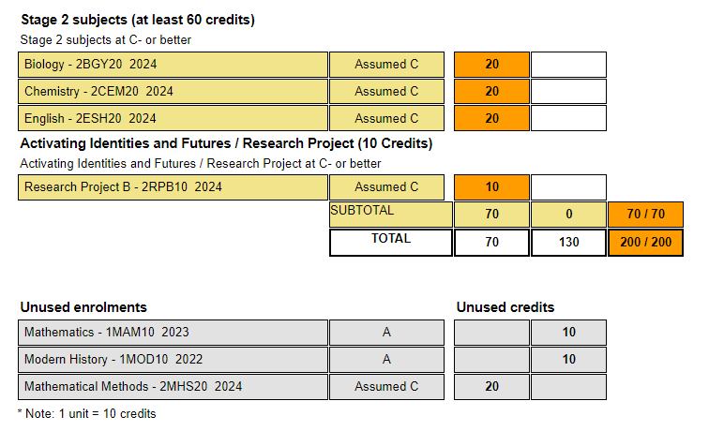
Stage 2 – Year 12 in 2025
Students continue to earn credits for subject & courses
Students need 200 total credits to achieve SACE
Students need 70 x Stage 2 credits to achieve SACE
Students need 90 x Stage 2 credits to achieve ATAR
Courses are graded A+ to E-
Students must get a C- grade or higher for all Stage 2 Subjects to complete SACE successfully
All subjects run for the full academic year and are worth 20 credits
At Stage 2, 30% of the assessment of every subject (e.g. investigations / exams) is marked by experts outside of the school (The SACE Board)
70% of the assessment of every subject is marked by Naracoorte High School teachers and moderated by the SACE Board

Slide 11
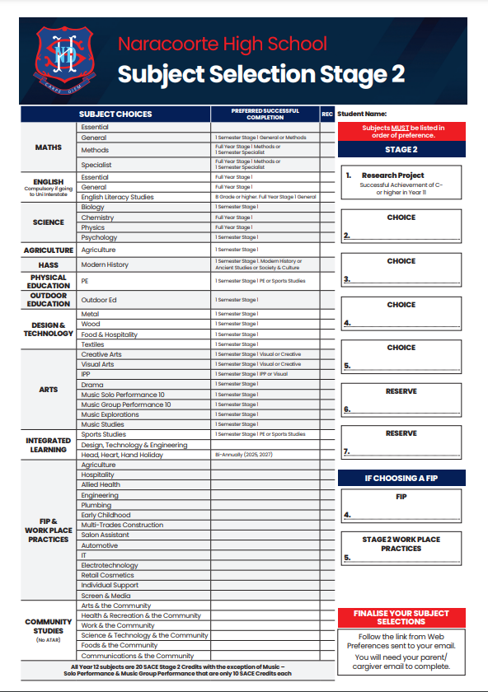
Year 11 into 12
Stage 2 2025
Compulsory Selections:
None Required
Elective Subjects
Students can choose any subjects pending preclusions – HG teachers to support any preclusions
Subject Recommendations
Curriculum Teachers have completed these
SACE Certificate
70 x stage 2 credits (pick 3 subjects)
ATAR
90 x Stage 2 Credits (pick 4 subjects)
AIF / Research Project
Equals 10 x Stage 2 Credits

Slide 12
Year 11/12 Home Group Teachers
John Flint - john.flint152@schools.sa.edu.au
Nadia Sears - nadia.sears738@schools.sa.edu.au
Gemma Borg – gemma.files987@schools.sa.edu.au
Elliot Johnson – elliott.johnson456@schools.sa.edu.au
Bron Longbottom – bronwyn.longbottom391@schools.sa.edu.au
Dylan Agnew – dylan.agnew185@schools.sa.edu.au
Emma Phillips – emma.bellgrove422@schools.sa.edu.au
Lisa Hurrell – lisa.hurrell19@schools.sa.edu.au
Bel Beggs – bel.beggs921@schools.sa.edu.au
Kinta Wilson - kinta.williams916@schools.sa.edu.au
Please contact your child’s Home Group teacher if you would like to book a meeting or discuss subject selection

Slide 13
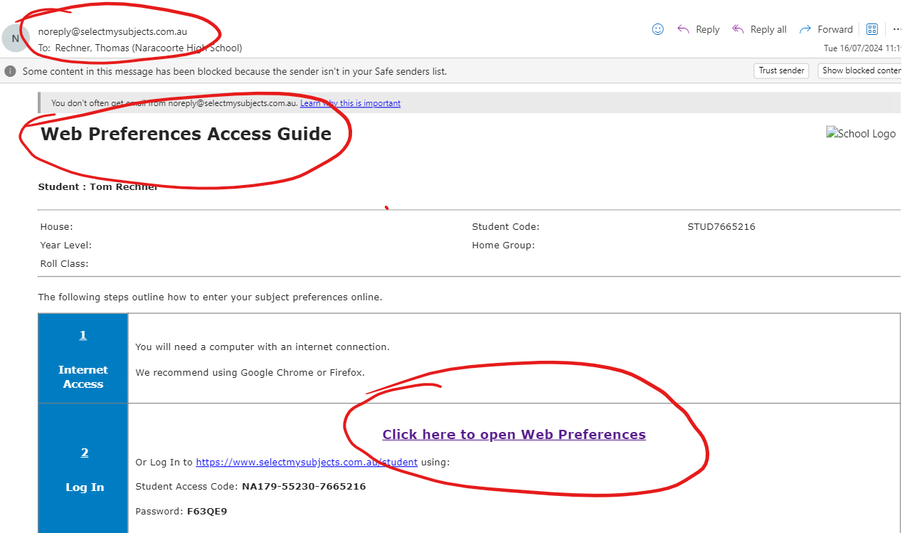
Web Preferencing

Slide 14
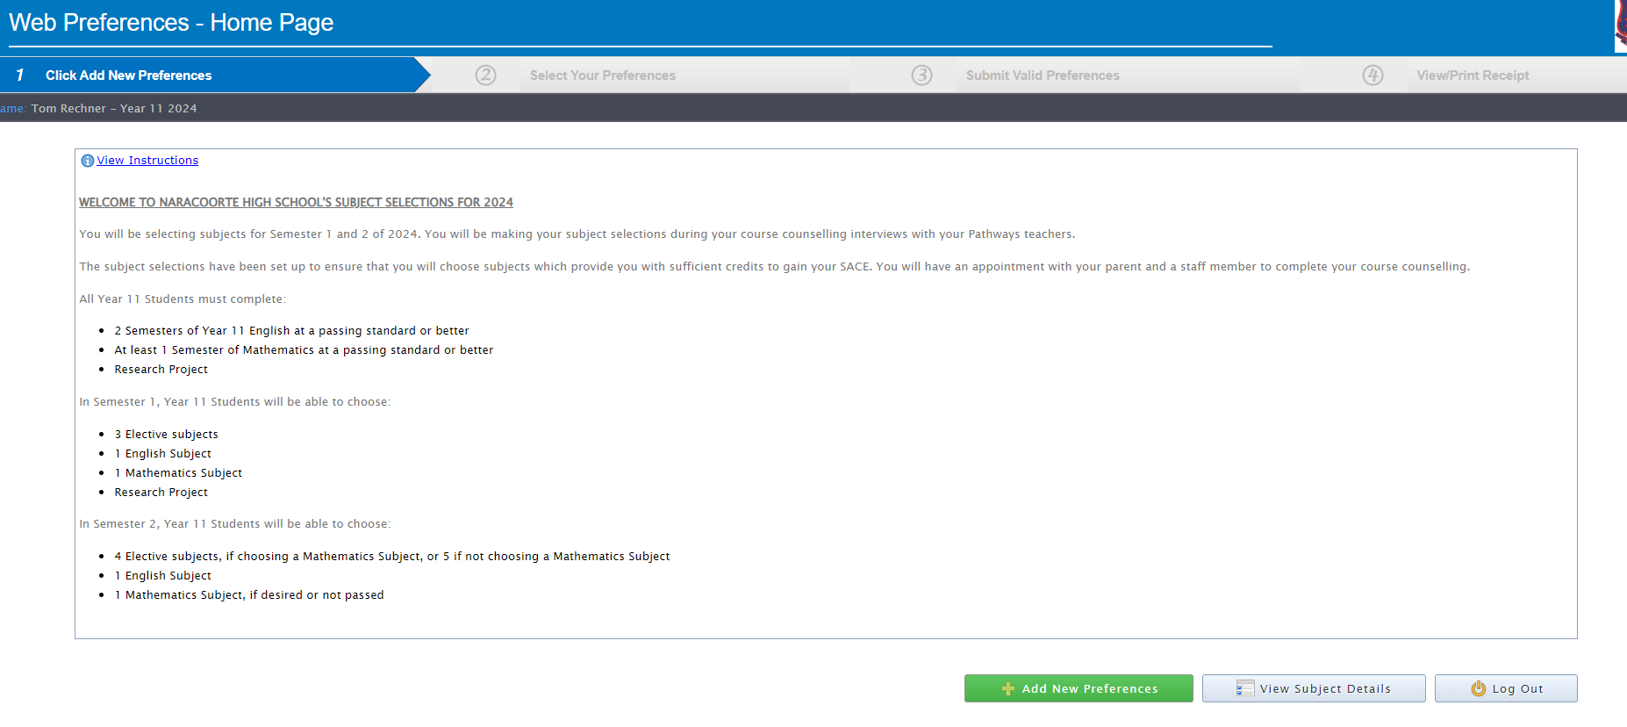
Web Preferencing

Slide 15
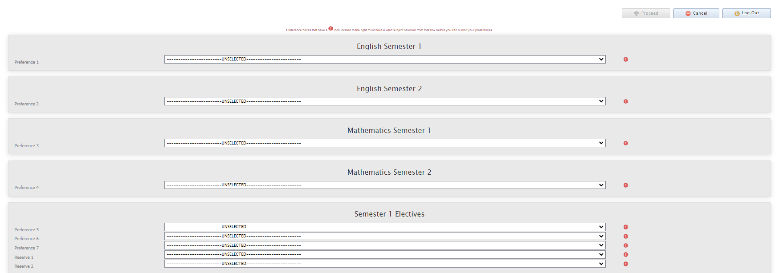
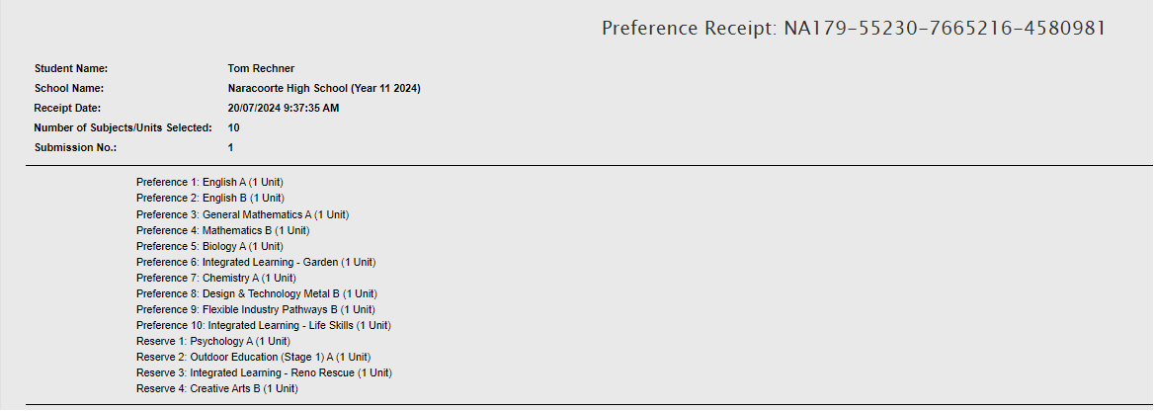
Web Preferencing

Slide 16
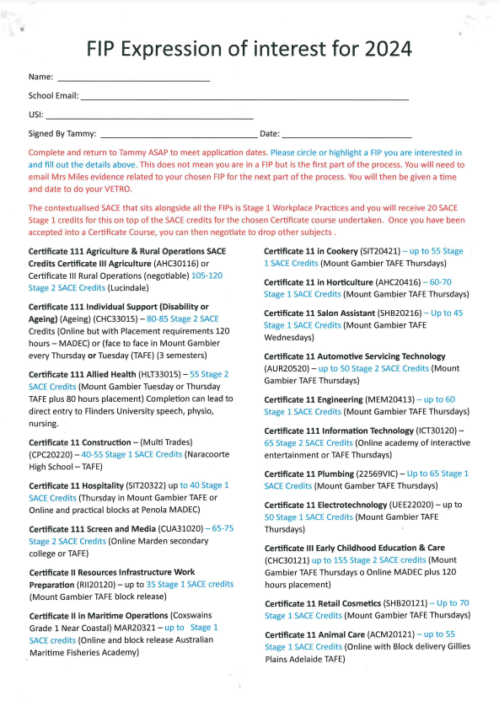
VET Course or FIP (Flexible Industry Pathway)
A Flexible Industry Pathway is a Certificate course, industry immersions, delivered with contextualised SACE. At Naracoorte High School, the contextualised SACE is Stage 1 compulsory subjects as well as 20 x credits of Stage 1 Workplace Practices.
Students are required to sit a VETRO exam to apply
See Expression of Interest sheet or visit https://www.sace.sa.edu.au/web/vet/vet-recognition-search for credit values
$$$ - Cost involved in all Cert III courses
For any more information, contact VET Coordinator Tammy Cane
tammy.cane985@schools.sa.edu.au

Slide 17
That’s It!

Slide 18
AUSTRALIAN Tertiary Admissions Rank issued by SATAC and used by universities to select students for courses
MEASURES a student’s overall achievement compared with all students nationally
RANGES from 0 to 99.95.
The score is calculated from your child’s 90 credit, Stage 2 results
Notes:
What is an ATAR?
An Australian Tertiary Admissions Rank is used by universities to select students for courses.
It measures a student’s overall achievement compared with all students nationally and ranges from 0 to 99.95
The score is calculated from your child’s 90 credit, Stage 2 results.

Slide 19
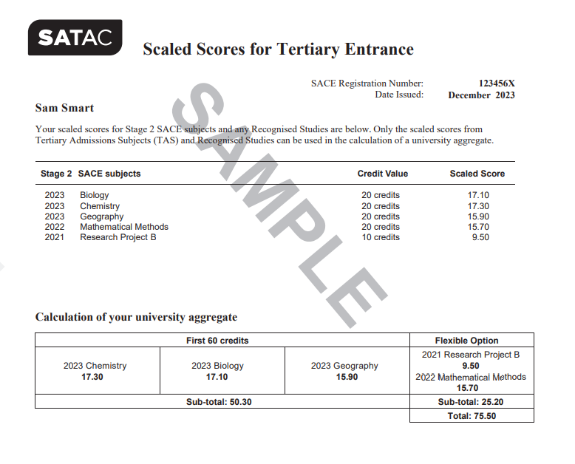
Notes:
University Aggregate

Slide 20
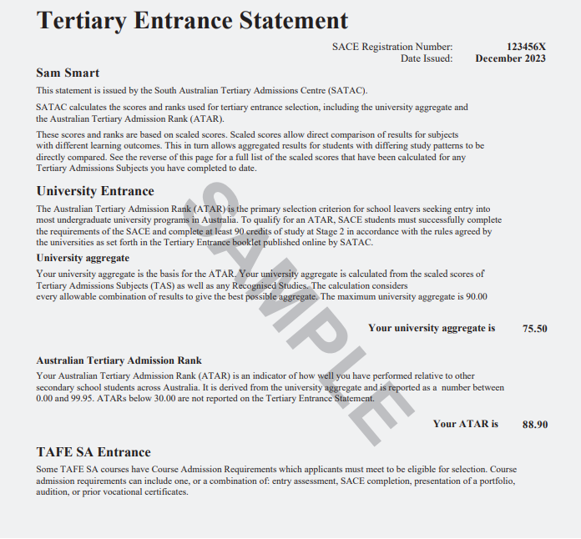
Notes:
Tertiary Entrance Statement

Slide 21
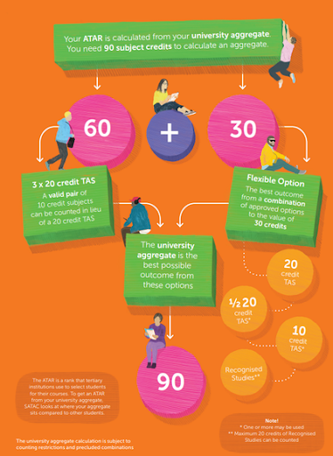
Almost all SACE subjects are recognised Tertiary Admissions Subjects, but there are some that aren’t recognised, and so can’t be used towards your ATAR:
Community Studies (Community Studies A and Community Connections)
Industry Connections
Modified Subjects​​​​​​​
local programs
You can use 20 x credits from a VET course towards you ATAR
HG teachers will help support students to ensure they are picking subjects that qualify for an ATAR if that is the student’s intention
Preclusions will also be discussed

Slide 22
SATAC may add adjustment factors to your university aggregate. We then use your adjusted aggregate to calculate your selection rank.
SATAC’s participating institutions have two schemes that provide adjustment factors to applicants:
The Universities Equity Scheme
The Universities Language, Literacy and Mathematics Scheme
SATAC administers these schemes on their behalf.
We will adjust your aggregate up to a maximum of 9 points:
5 points under the Universities Equity Scheme
either 2 or 4 points under the Universities Language, Literacy and Mathematics Scheme
Naracoorte High School is a school that qualifies under the Universities Equity Scheme in 2024.
Scaling & Bonus Points
https://www.satac.edu.au/scaling
https://www.satac.edu.au/adjustment-factors Learn more about scaling and adjustment factors

Slide 23
Scaling Information

Slide 24
WHAT…
am I interested in and good at?
sort of job, or types of work, will help me follow my interests?
subjects do I need to study to follow my chosen career pathway?
do I hope to gain from my studies?
have I learned during my PLP & Pathways course and Pathways to a Pay Packet?
Are the pre-requisites for any Tertiary entrance?
Find out more at sace.sa.edu.au/studying/subjects
Notes:
Questions for your child to ask themselves:
What am I interested in?
What am I good at?
What sort of job, or types of work, will help me follow my interests?
What subjects do I need to study to follow my chosen career pathway?
What I hope to gain from my studies?
What have I learned during my PLP course?
TIP – encourage them to try and choose subjects that will open doors to a range of careers within their area of interest
This will give them greater flexibility if they want to change or modify their choice in the future.
You can find out more about credits and choosing subjects, VET courses and recognised learning on the SACE website.

Slide 25
THE SACE Board supports students by working with schools to provide reasonable adjustments where appropriate.
SPECIAL provisions support eligible students to ensure they have the opportunity to positively demonstrate their skills and understanding of the subject.
https://www.sace.sa.edu.au/web/special-provisions
MODIFIED subjects are available for students with significant impairment in intellectual functioning and/or adaptive behaviours associated with their disability.
https://www.sace.sa.edu.au/web/modified-subjects
Notes:
Sometimes a student’s journey is complicated by disability, misadventure or personal circumstances.
Special provisions
Special provisions are a range of adjustments that are made to allow eligible students to access learning and assessment on the same basis as other students. These might be adjustments such as extra time for tests, extended deadlines or using adaptive technology.
Special provisions are available in stages 1 and 2 and for both the school assessed and externally assessed components. Special provisions may administered for a short term or on a long term basis according to the needs of the student. Each case is individual.
Modified Subjects
Access to modified subjects is intended for the small number of students with significant impairment in intellectual functioning and/or adaptive behaviours associated with their disability, whose learning needs cannot be met through differentiation or special provisions.
This group of eligible students has access to modified subjects which focus on personalised learning goals and the development of the capabilities.
Subjects are assessed as ‘Completed” or ‘Not Completed”.
Eligible students may also access the full range of flexible subjects and VET to complete their SACE.
www.sace.sa.ed.u.au/web/modifed-subjects

Slide 26
RESULTS
Your child will receive their final results in Students Online on the SACE website. sace.sa.edu.au
SATAC
Provides students with their ATAR satac.edu.au
Notes:
At the end of Stage 2, your child will receive their final results for all SACE subjects they have completed. These grades are available in Students Online on the SACE website.
On the same day the South Australian Tertiary Admissions Centre (SATAC) will release the ATAR and your child will be able to find out if they are eligible for:
an Australian Tertiary Entrance Rank (ATAR) which they can use to apply for university

Slide 29
UNIVERSITY
COMPLETED the SACE with at least 90 credits at Stage 2
GAINED a university aggregate and an ATAR
MET any university prerequisite requirements and rules
APPLIED through the South Australian Tertiary Admissions Centre (SATAC).
Notes:
Achieving the SACE is important if your child wants to study at TAFE or university, but there are also other pathways after secondary school. The SACE also offers the flexibility to move smoothly from high school to employment.
University pathways
Successful completion of the SACE is the most common way for students to gain entry to local and international universities.
To be eligible to apply for university, South Australian students must have:
completed the SACE with at least 90 credits at Stage 2
gained a university aggregate and an ATAR
met any prerequisite subject requirements for their chosen university course
complied with rules regarding subject combinations and counting restrictions
Application for entry to university courses is made through the South Australian Tertiary Admissions Centre (SATAC). More information is available in the SATAC booklet and on the SATAC website www.satac.edu.au.

Slide 30
TAFE
ENTRY requirements and a list of all the courses offered by TAFE can be found at tafesa.edu.au
PREPARES your child for employment in professional, para-professional, technical and trade careers
Notes:
TAFE pathways
TAFE SA campuses offer courses to prepare your child for employment in professional, para-professional, technical and trade careers.
Entry requirements may vary depending on the level of the qualification.
Details of these requirements and a list of all the courses offered by TAFE can be found on the TAFE website.

Slide 31
EMPLOYMENT AND TRAINING
TRAIN in a recognised VET course or school-based apprenticeship
while completing the SACE
GET a head start on their career
CHOOSE from a wide range of industry areas
Find a list of VET courses at https://www.sace.sa.edu.au/
Notes:
Employment and training
The SACE offers the flexibility to move smoothly from high school to employment.
VET courses can count towards their SACE at both Stage 1 and Stage 2. This means they can be working towards, or may even have gained, a VET qualification by the time they finish the SACE – giving them a head start on their career and employment.
After completing their SACE your child can continue with their chosen pathway or start a new one, choosing from a wide range of industry areas, including construction, automotive, electro technology, hospitality, community services, health and information technology.
More information is available at www.skills.sa.gov.au/careers-jobs

Slide 32
OUR SCHOOL is here to provide information to you and your child
MY DETAILS
Tom Rechner
PHONE: 8762 1333
EMAIL:
Tom.Rechner439@schools.sa.edu.au
HELP your child select subjects that suit their interests and future plans
ADVISE them on the best subjects and VET courses to take for their preferred tertiary education course or area of employment
Notes:
Our school
Our school’s SACE coordinator, teachers and other school leaders are here to help and can:
Offer advice and information on the subjects being offered
Help your child select subjects that suit their interests and plans
Advise your child about the best subjects to take to prepare for their preferred tertiary education course or area of employment
Advise your child on vocational education and training (VET) options available to them, through our school or a registered training organisation (RTO).

Slide 33
?
Notes:
If you are looking for ways to further support your child through their SACE journey, more information can be found under ‘studying the SACE’ on the SACE website www.sace.sa.edu.au
Alternatively contact the SACE Board at:
60 Greenhill Road, Wayville
South Australia, 5034
8115 4700
SACE.Info@sa.gov.au

